Slide 1
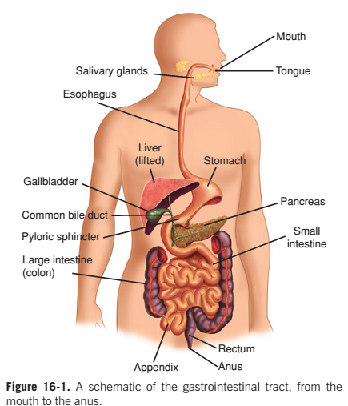
Gastrointestinal tract
The gastrointestinal tract is a hollow digestive tube that extends through the center of the body from the mouth to the anus
The primary function of the gastrointestinal system is digestion and nutrient uptake.
The oral cavity and the colon are at opposite ends of the tube and are heavily colonized with bacteria, and the central part of the tube, the stomach, duodenum, jejunum, and the proximal half of the ileum, are lightly colonized

Slide 2
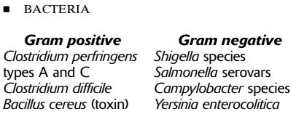
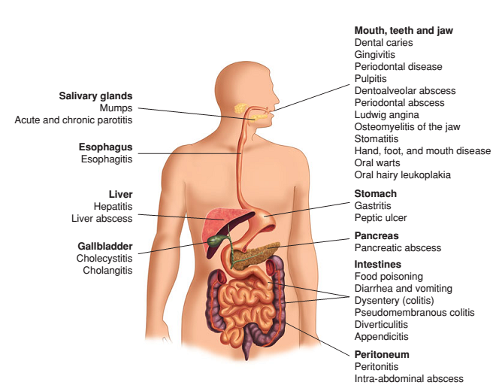
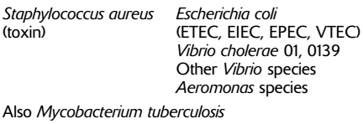
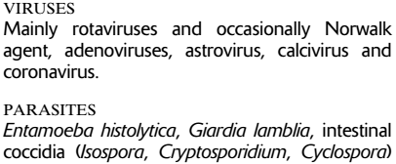
Etiology of Gastrointestinal Disease

Slide 3
Salmonella

Slide 4
General characteristics
Salmonella belong to the bacterial family, Enterobacteriaciae.
They are facultative anaerobic gram negative bacilii measuring about 1-3μm x 0.5μm in size, non capsulated, non-sporing bacteria.
Most are motile (due to peritrichous flagella) except S gallinarum and S pullorum.
Two species of Salmonella. Eg Salmonella bongri and Salmonella enterica
More than 2000 different serotypes of Salmonella. (They were originally classified as separate species but it is now generally accepted as serotype of a single species Salmonella enterica. This species consists of 7 subspecies (sub group)
Salmonella spp. are relatively resistant to bile acids.

Slide 5
Contd……………
Are mesophilic with optimum growth temperature between 35-37⁰C.
They ferment glucose with the production of gas but do not ferment lactose and sucrose.
Utilize citrate as carbon source, produce H₂S gas.

Slide 6
Salmonella are the cause of two diseases commonly called salmonellosis:
-enteric fever(typhoid), resulting from bacterial invasion of the bloodstream, and
-acute gastroenteritis, resulting from a foodborne infection/intoxication.

Slide 7
Medically important salmonella serotype
S. Typhi
S. Paratyphi A
S. Paratyphi B
S. Paratyphi C
S. Typhimurium
S. Enteritides

Slide 8
Antigenic structure
Somatic antigen (O antigen)
Flagellar antigen (H antigen)
Surface antigen (Vi)

Slide 9
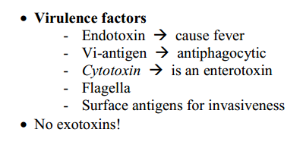
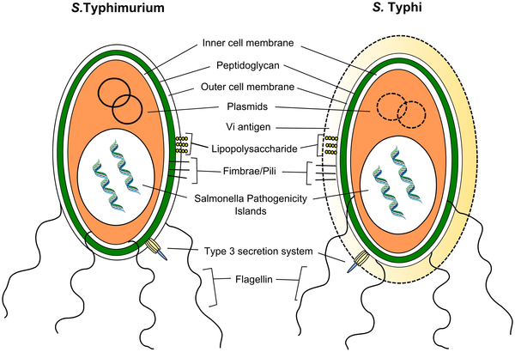

Slide 10
Gastroenteritis
Gastroenteritis means irritation and inflammation of the gastrointestinal tract, which includes the stomach and small and large intestines. The condition is usually due to bacteria, food poisoning, parasites, or viruses, and it often results in diarrhea, abdominal pain, nausea, and vomiting
Pathogensis
ingestion
absorbed to brush border of epithelial cells of small intestine and colon
migrate to lamina propria, ileocaecal
multiply in lymphoid follicles
reticuloendothelial hyperplasia and hypertrophy
Notes:
The lamina propria (more correctly lamina propriamucosæ) is a thin layer of loose connective tissue, or dense irregular connective tissue, which lies beneath the epithelium and together with the epithelium constitutes the mucosa.
The ileocecal valve is a sphincter muscle valve that separates the small intestine and the large intestine. Hyperplasia or hypergenesis, is an increase in the amount of organic tissue that results from cell proliferation. IHypertrophy is the increase in the volume of an organ or tissue due to the enlargement of its component cells

Slide 11
Salmonella: Gastroenteritis
Transmission:-contaminated food(foods of animal origin has been associated with large number of out break)
Number of ingested Salmonella needed to an infection varies with the strain of organism and the characteristics of the individuals ingesting the organism.
Healthy adult males can ingest 10⁵ t0 10⁷ cells before symptoms of the illness occur.
incubation 6-48 hrs.
nausea, vomiting, diarrhea, fever, abdominal cramps, malaise, headache
2 days - 1 week: usually spontaneous resolution

Slide 12
Contd
After ingestion, the bacilli attach to epithelial cells of villi of small intestine and pass through them into sub mucus coat where they are phagocytosed by neutrophil and macrophage.
They resist intracellular killing and multiplies within phagocytic cells.
The cells then enter blood through lymphatic system and results in transient bacteriaemia (primary bacteriaemia).

Slide 13
From blood they infect Reticulo Endothelial system (liver, gall bladder, lymph node, Spleen, Lungs, Kidneys and bone marrow) in 7 days.
By 10th day, the parasitised cells get necrosis and bacilli enters blood causing secondary bacteremia.
During this, the bacteria releases endotoxin which causes pyrexia and other clinical signs.

Slide 14
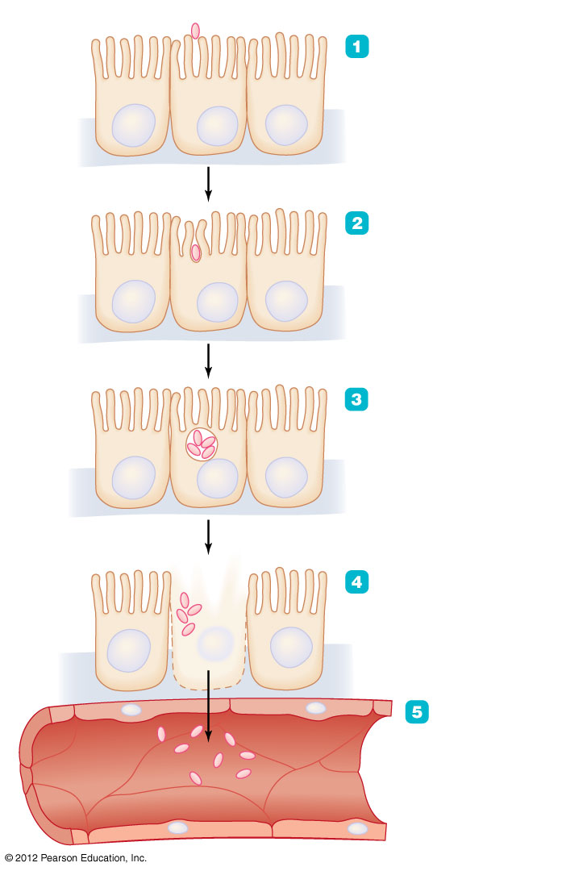
Figure 23.10 The events in salmonellosis
Salmonella
Salmonella attaches to epithelial cells lining the small intestine.
Epithelial cell
Nucleus
Salmonella triggers endocytosis.
Salmonella multiplies within food vesicle.
Salmonella kills host cell, inducing fever, cramps, and diarrhea.
Capillary (blood vessel)
Bacteremia: Salmonella moves into bloodstream.

Slide 15
Typhoid fever
Route of transmission: ingestion of contaminated food and water.
Formly S. Typhi causes typhoid fever . Other serotypes also cause similar clinical syndrome which include:
●Salmonella Paratyphi A
●Salmonella schottmuelleri (formerly Salmonella Paratyphi B)
●Salmonella hirschfeldii (formerly Salmonella Paratyphi C)
●Salmonella choleraesuis The incubation period is usually 7 to 14 day.

Slide 16
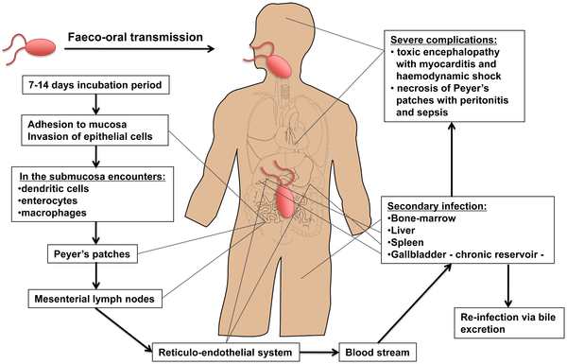
Dissemination of S. Typhi during systemic infection

Slide 17
Typhoid is usually contracted by ingestion of food or water contaminated by fecal or urinary carriers excreting S. Typhi. The incubation period is usually 7 to 14 days.
In the small intestine the bacteria adhere to the mucosa and then invade the epithelial cells.
The Peyer's patches, which are aggregrated lymphoid nodules of the terminal ileum, play an important role in the transport to the underlying lymphoid tissue.
Specialized epithelial cells such as M cells overlying these Peyer's patches are probably the site of internalization of S. Typhi. Once the bacteria have penetrated the mucosal barrier, the invading organism translocates to the intestinal lymphoid follicles and the draining mesenteric lymph nodes, and some pass on to the reticuloendothelial cells of the liver and spleen.
During the bacteremic phase, the bacteria are widely disseminated throughout the body. Secondary infection can occur with liver, spleen, bone-marrow, gallbladder, and Peyer's patches as the most preferred sites.

Slide 18
The gallbladder is the main reservoir during a chronic infection with S. Typhi and invasion occurs either directly from the blood or by retrograde spread from the bile.
The ability of Salmonella to form biofilms on gallstones is likely to be a critical factor in establishment of chronic carriage and shedding of S. Typhi.
The bacteria that are excreted in the bile can then reinvade the intestinal wall by the mechanism previously described or are excreted by feces.

Slide 19
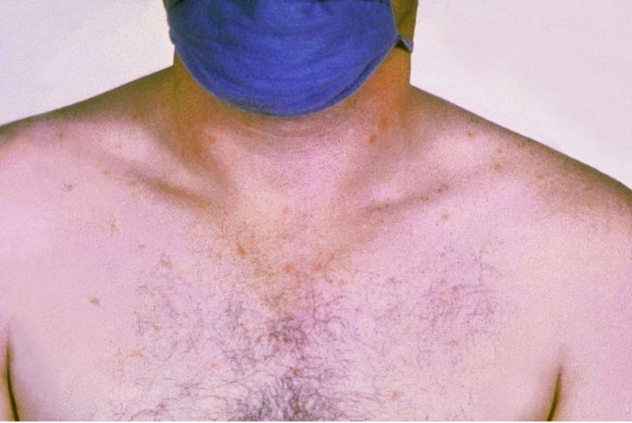
Clinical manifestation
Headache
Malaise
Fever
Anorexia
coated tongue
Abdominal discomfort
Hepatomegaly
Rose spots
Pyrexia etc.
The most severe manifestations of typhoid leading to sepsis and death are either necrosis of the Peyer's patches resulting in gut perforation and peritonitis or a toxic encephalopathy associated with myocarditis and haemodynamic shock.
Notes:
Pyrexia:- raised body temperature
Encephalopathy:-a disease in which the functioning of the brain is affected by some agent or condition (such as viral infection or toxins in the blood

Slide 20
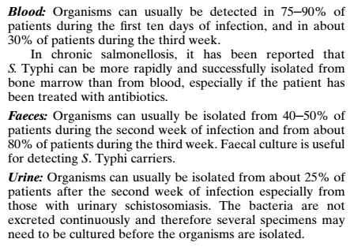
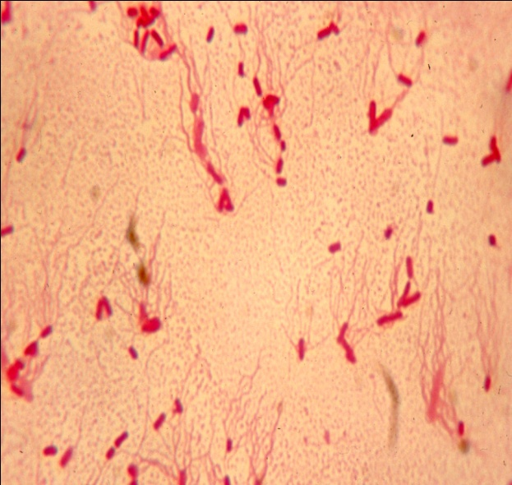
Laboratory diagnosis
Sample: blood, stool, urine, bone marrow, bile
Microscopy
- Gram negative bacilli arranged mainly in singly.

Slide 21
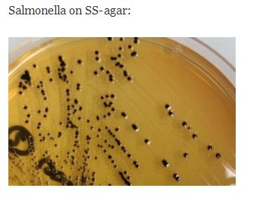
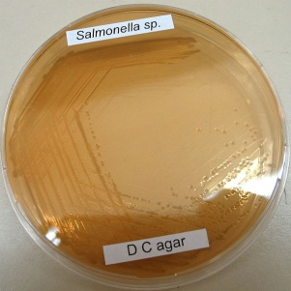
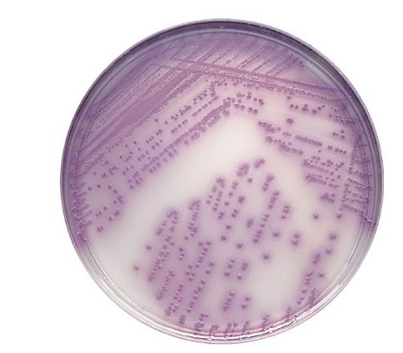
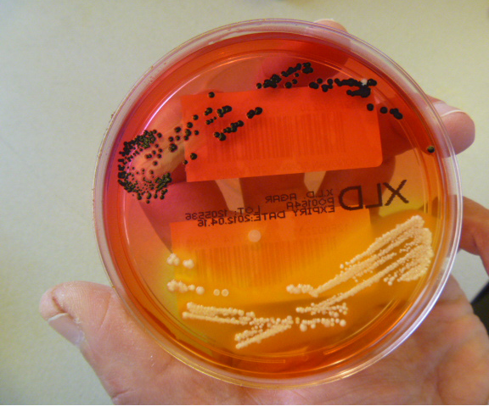
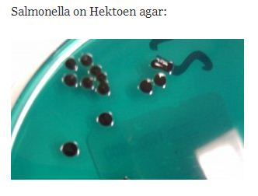
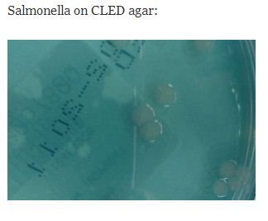
Culture
Blood sample culture on biphasic media
They are facultative anaerobic
On BA(blood Agar), gives colourless non haemolytic colonies.
On MA(Mac Conkey Agar), gives colourless NLF colonies.
On DCA(Deoxycholate Citrate Agar), gives NLF, pale colonies with black centres.
Selenite F broth
Tetrathionate broth
Other selective media
Wilson and Blair Bismuth sulphite media
XLD(Xylose Lysine Deoxycholate) Agar
SS (Salmonella Shigella)Agar
Hektoen enteric (HE) Agar
BBL CHROMagar (violet colored)

Slide 22
Serological diagnosis
Antibody detection- Widal test
Qualitative test
Quantitative test:Two specimens of serum are required at an interval of 7-10 days and a four-fold rise in the titres of H (flagellar) or O (somatic) agglutinins indicates a strong likelihood of the disease.

Slide 23
Haemagglutination (HA) Tests
Antigen detection test
Proteins antigens and Vi
DNA detection test

Slide 24
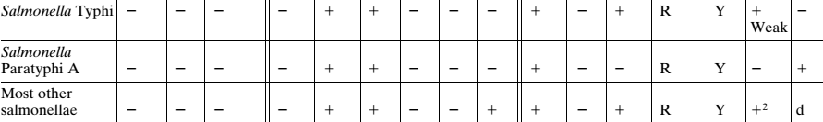
Biochemical test

Slide 25
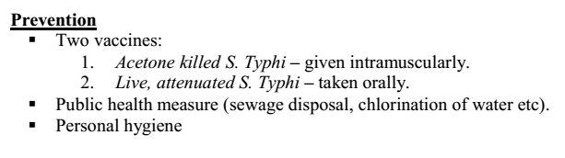
Antibiotics used
Chloramphenicol, cotrimoxazole, ampicillin, cloxacillin, ciprofloxacin and ofloxacin.
Ampicillin and trimethoprim–sulfonamide have been used successfullyto treat infections caused by chloramphenicol-resistant strains.
Newer cephalosporins (ceftriaxone) and quinolones (ciprofloxacin, norfloxacin) are also effective.
Prevention
provision of clean water supplies and the treatment of carriers
Typhoid vaccines

